Slide 1
#1
Elm Street
FP
River Road
FP
#4
FP
Union Ave
#4
Apartments
Coventry Mall
FP
Fisher Ave
#4
Kerline Ave
Residential Homes
CVS
FP
#4
Bank
Hanover Road
Laurelwood Road
#1
Kline Ave
Fast Food
Stores
Westbound Lane from Rte. 100
Stores
FP
#4
Route 724
Overpass Route 100
FP
#2
FP
FP
#4
#4
#4
#4
#4
#4
#2
FP
#3
FP
FP
Cedarwood Road
For Westbound traffic on Rte. 724
Road Closed sign at Ramp off Rte. 100
Road Closed sign at Laurelwood and Rte. 724
Road Closed sign at Hanover to Rte. 724
Road Closed electronic sign at Laurelwood and Elm Street prior to River Road Southbound lane
For Eastbound traffic on Rte. 724
Detour sign at Ramp off Rte. 100 directing all traffic right at the end of the exist
FP
Race Begins
N
Wawa
Norco Fire Company
Race Ends
W
E
*
Urner St
Eastbound Lane from Rte. 100
*Parking available at this location
FP = Fire Police
S

Slide 2
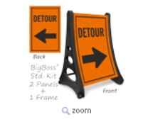
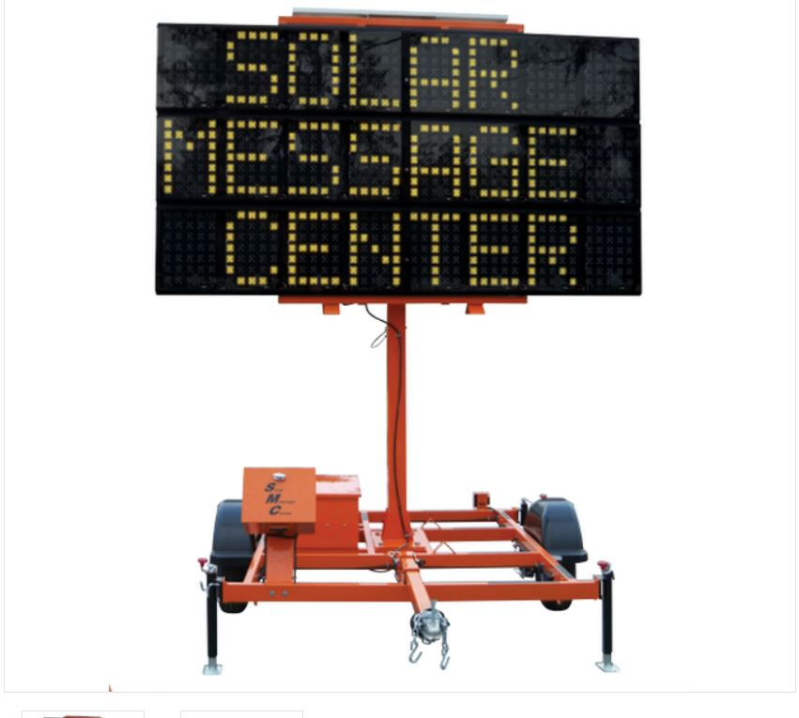
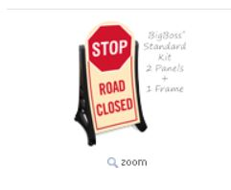
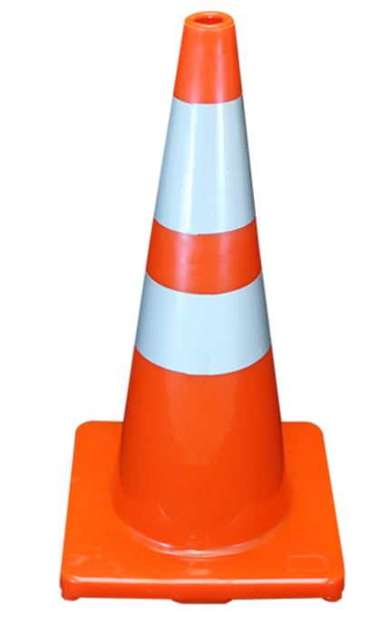
#1
#3
#4
#2

Slide 3
